Slide 1
Lecture Seven
The State of Things

Slide 2
Critical Infrastructure?
Is space critical infrastructure?
GPS?
Comms?
Its all about time.
Does it need to be to drive policy?
It should be next year (in the US)
Until that happens…no DHs / CISA focus

Slide 3
Current-ish Affairs
US space tech giant Maxar discloses employee data 11/18/2024
breachhttps://www.bleepingcomputer.com/news/security/us-space-tech-giant-maxar-discloses-employee-data-breach/
Hackers breached U.S. satellite maker Maxar Space Systems and accessed personal data belonging to its employees, the company informs in a notification to impacted individuals.
Space industry, but normal security issue
Potentially enables actual space system cyber attack
Somebody moved UK's oldest satellite, and no-one knows who or why 11/8/2024
Someone moved the UK's oldest satellite (1970’s) and there appears to be no record of exactly who, when or why. “curiously, Skynet-1A is actually half a planet away, in a position 22,369 miles (36,000km) above the Americas.”
Most likely in some sort of graveyard orbit
Probably a nothing, however quite the inflammatory article title

Slide 4




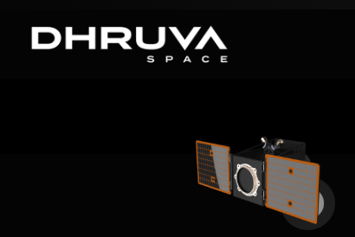

Hosted Payload Providers

Slide 5









Bus Vendors
AIRBUS
Blue Canyon
Honeywell
Lockheed Martin
Loft Orbital
Northrop Grumman
Thales

Slide 6





Launch Vendors
Arianespace
Blue Origin
Rocket Lab
SpaceX
United Launch Alliance

Slide 7

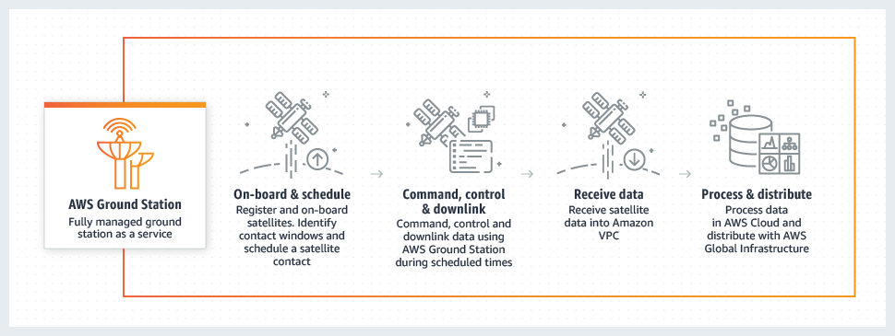

GSaaS & GEPs
Ground Station as a Service & Ground Entry Point Vendors
Satellite As A Service - AWS Ground Station
Azure Orbital Ground Station as Service
KSAT Global Ground Station Network

Slide 8
Non-Cyber Concerns
OSINT Satellite Tracking
Lasers
Missiles

Slide 9
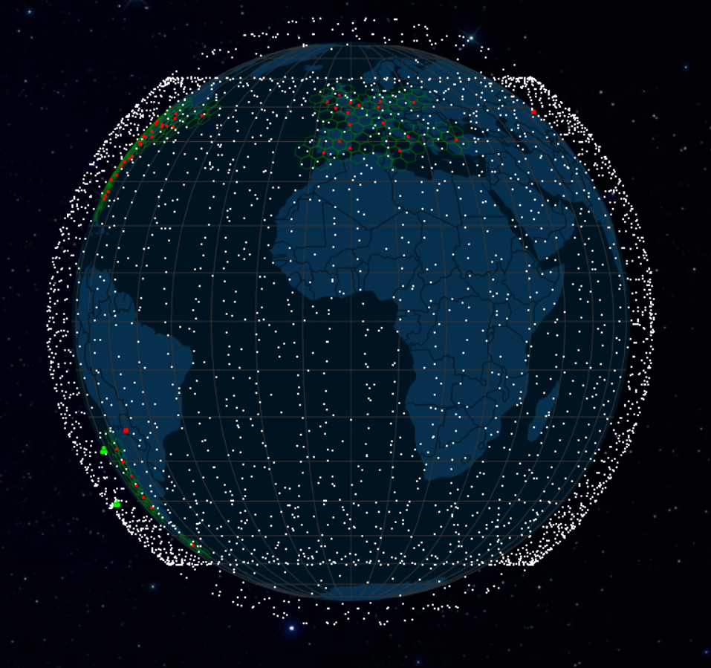
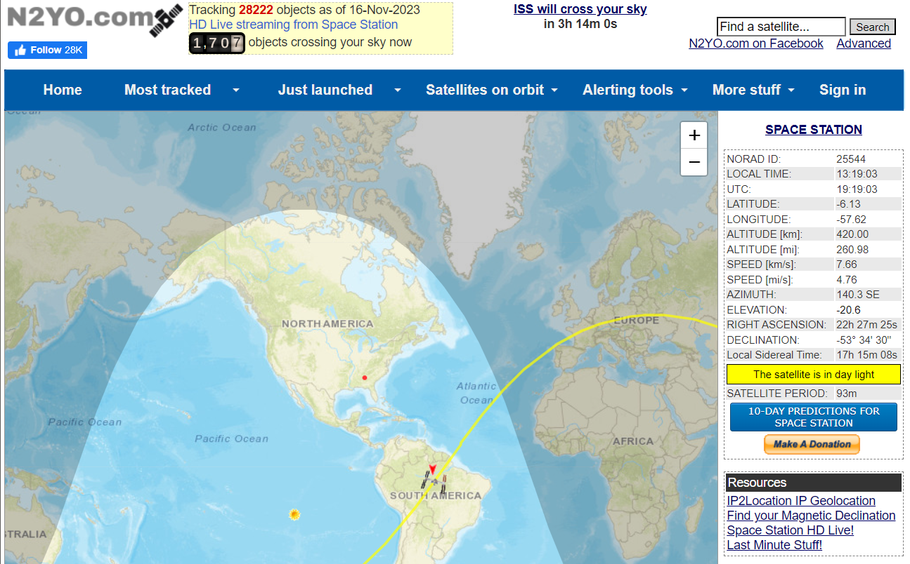
OSINT Satellite Tracking
https://satellitemap.space/ https://www.n2yo.com/

Slide 10
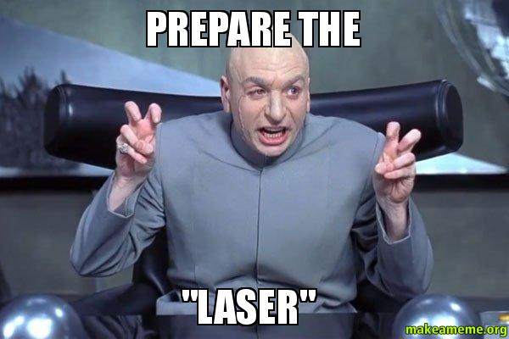
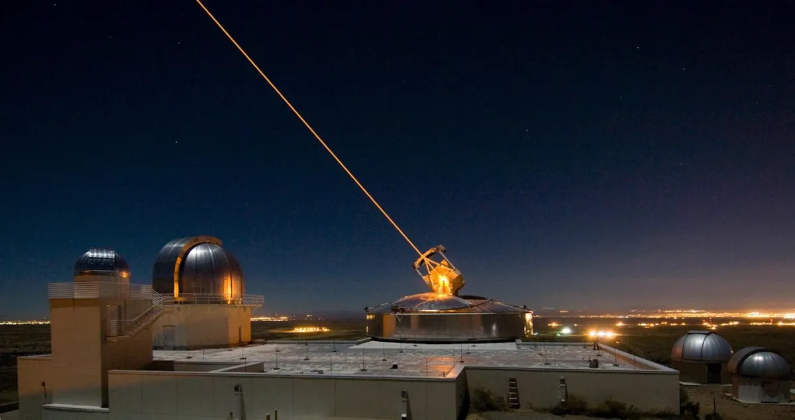
Lasers
US Army successfully tested the TRW-built Mid-Infrared Advanced Chemical Laser (MIRACL) at the White Sands Missile Range, New Mexico, on 17 October, 1997
https://www.flightglobal.com/anti-satellite-laser-test-is-successful/17857.article
Russia and China are attacking US satellites with lasers
https://www.independent.co.uk/space/russia-china-attack-us-satellites-lasers-b1972406.html

Slide 11
Laws and Agreements
International Heritage Laws
The Outer Space Treaty
The Rescue Agreement
The Moon Agreement
The Liability Convention
The Registration Convention
The Artemis Accords

Slide 12
Space System Cybersecurity Customer Base
Military
Intelligence
Other government (weather for instance)
Commercial
Space-based services
Space as a Service
Hosted payloads
Satellite builders / operators

Slide 13
Academia & Education
Capitol University - PhD in Space Cybersecurity
Embry-Riddle – Bachelors in Space Operations
John Hopkins Engineering – Space Systems Cybersecurity Course
Cornell – Space cybersecurity programs being developed and courses taught
Strathclyde Business School – Space Cybersecurity course, Space Studies Master’s Program
Airbus Cybersecurity School
Introduction to Cybersecurity in Space Systems: Hardware Edition with Tim Fowler by Antisyphon Training
Stellaryx Labs with Angelina Tsuboi
ethicallyHackingspace (eHs)® h4ck32n4u75™ (Hackernauts) with William Ferguson
Us…obviously (GIT, books etc)

Slide 14
Conferences
Black Hat
DEFCON
HackSpaceCon
CyberSatGov US
CySat Paris
Value of Space Summit
SmallSat
Space Symposium
ESA Space Cyber Conference
ESA Security Conference

Slide 15
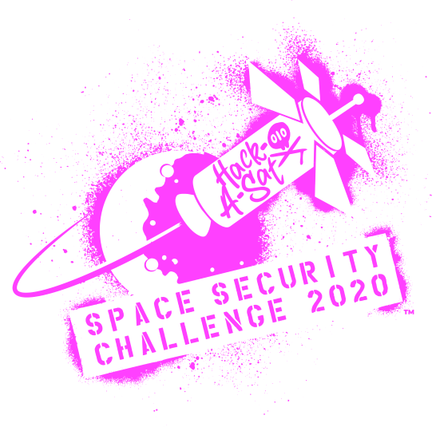
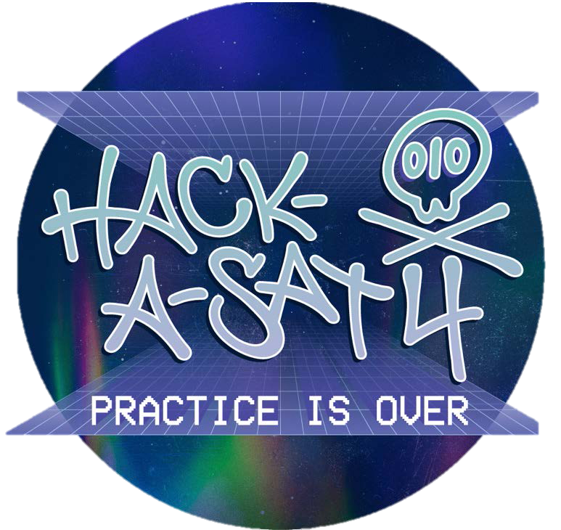
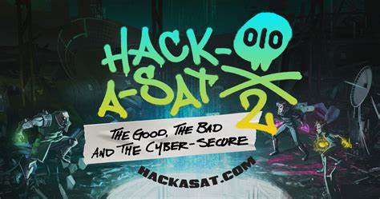

RIP Hack-a-Sat
Hack-a-Sat is a CFT style compotation funded by the United States Department of Defense.
It consists of a thirty-hour qualifying round and a final competition that takes place yearly at Las Vegas during DEFCON. The top eight teams receive $10,000 each.
To receive qualification event cash prizes, the top eight teams must submit technical papers to describe how they hacked the satellite.
Winning teams take home prize money in the ranges of $20,000-$50,0000.
To take home prize money, a technical paper must be submitted to describe the entire approach to winning the game.

Slide 16

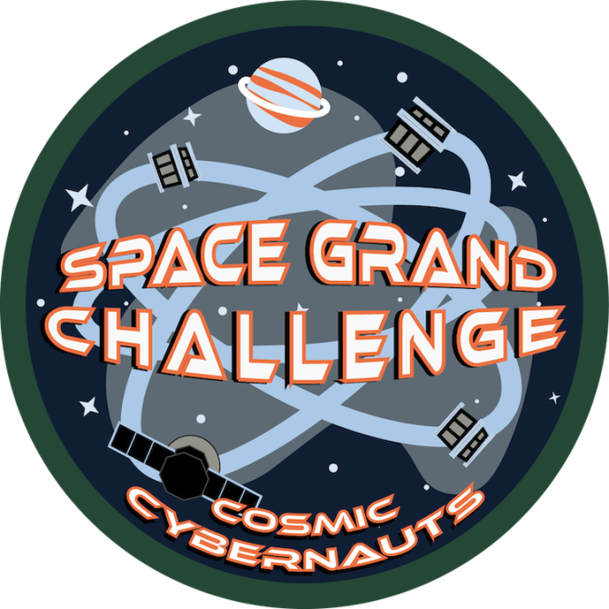
Space Grand Challenge
The Space Grand Challenge (SGC) Program is a free virtual game-based cybersecurity competition for middle and high school students built by Cal Poly students. The SGC helps prepare the next generation of the cyber workforce by expanding the pipeline of talent earlier, promoting STEM, and developing cyber/IT skills. SGC accomplishes this through a unique use of gamification and esports to promote STEM, space themes, and cybersecurity skills.
https://cci.calpoly.edu/empower/space-grand-challenge-program

Slide 17

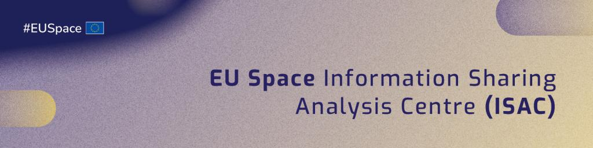
Space ISAC
Space ISAC Mission
The Space ISAC serves to facilitate collaboration across the global space industry to enhance our ability to prepare for and respond to vulnerabilities, incidents, and threats; to disseminate timely and actionable information among member entities; and to serve as the primary communications channel for the sector with respect to this information.
Space Information Sharing and Analysis Center (Space ISAC) is a direct result of a study conducted by the Science & Technology Partnership Forum in 2017. Public and private sector dialogue during sessions held at the 34th and 35th Space Symposium led NASA, U.S. Space Force (formerly Air Force Space Command), and the National Reconnaissance Office to sponsor the first Space dedicated ISAC. At the Space ISAC’s launch in April 2019, several representatives from public and private sectors spoke out about the importance of protecting our critical space assets.
Space ISAC joined as an official member of the National Council of ISACs in 2020.
EU has its own, though Space ISAC in USA Claims to be the worldwide one

Slide 18

Aerospace Village
AV Mission
Build, inspire, and promote and inclusive community of next-generation aerospace cybersecurity expertise and leaders.
AV Goal
The Aerospace Village is a diverse community of hackers, engineers, pilots, policy leaders and more from across both the public and private sectors. We believe the flying public deserves safe, reliable, and trustworthy air travel, which is highly dependent on secure aviation and space operations.

Slide 19
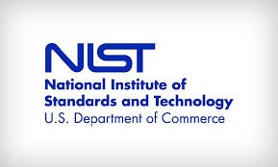


Guidance / Standards / Policy
Standard software: NASA Core Flight Executive (cFE), COSMOS, CESIUM
NIST – system overlays
IEEE - secure by design pinciples
CCSDS – Architecture framework for space system design

Slide 20

CCSDS
The Consultative Committee for Space Data Systems (CCSDS) was formed in 1982 by the major space agencies of the world to provide a forum for discussion of common problems in the development and operation of space data systems. It is currently composed of 11 member agencies, 32 observer agencies, and over 119 industrial associates.
Since its establishment, it has been actively developing standards for data-systems and information-systems to promote interoperability and cross support among cooperating space agencies, to enable multi-agency spaceflight collaboration (both planned and contingency) and new capabilities for future missions. Additionally, CCSDS standardization reduces the cost burden of spaceflight missions by allowing cost sharing between agencies and cost-effective commercialization.

Slide 21
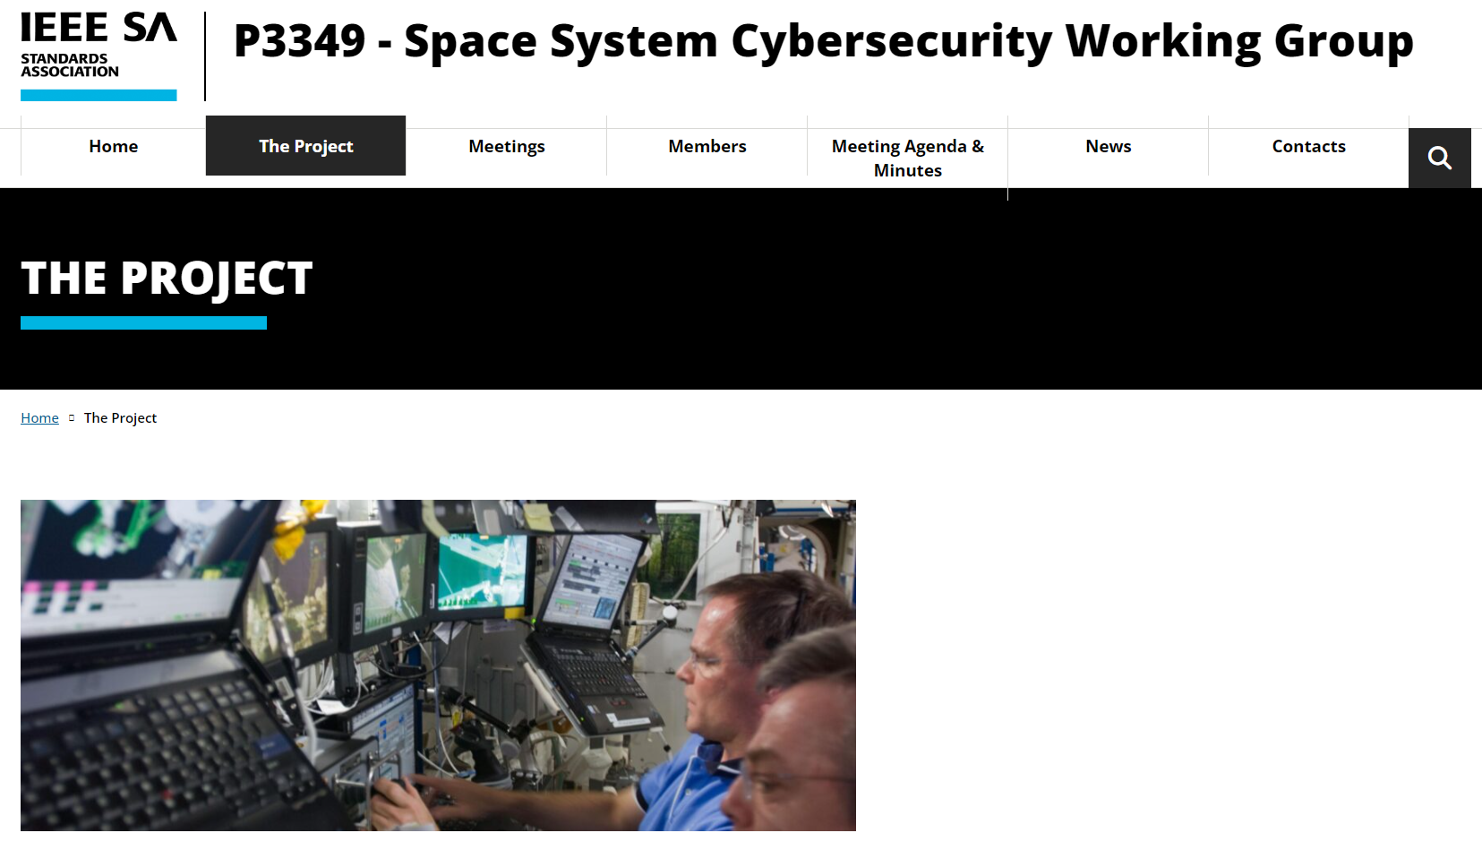
https://sagroups.ieee.org/3349/the-project/

Slide 22
The IEEE Effort
Intention: Secure by design
Based on security design principles, not technical implementations
CCSDS & architectural concerns vs IEEE
Not a regulation or standard but an international guideline
Papers
Minimum Requirements for Space SystemCybersecurity - Ensuring Cyber Access to Space
Secure-by-component: A System-of-systems Design Paradigm for Securing Space Missions

Slide 23
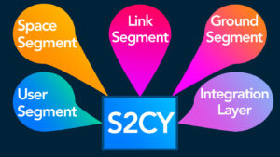
The IEEE Effort
Ground segment
Link segment
Space segment
User segment
Integration segment

Slide 24
From CISA Recommendations to Space System Operators for Improving Cybersecurity

Slide 25
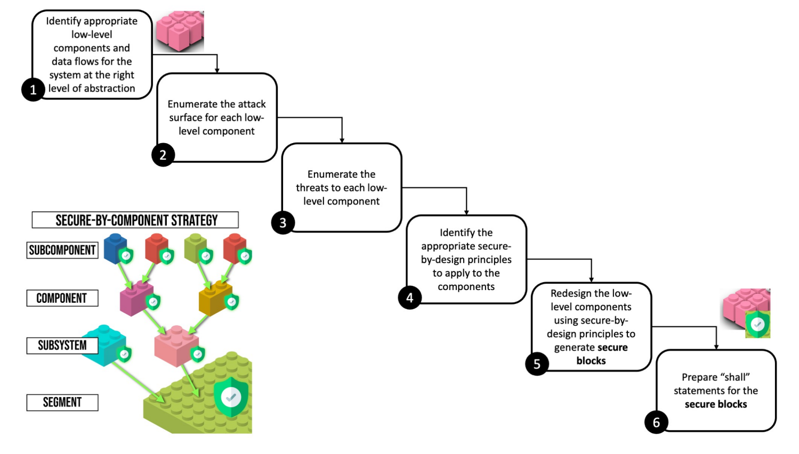
The IEEE Effort

Slide 26
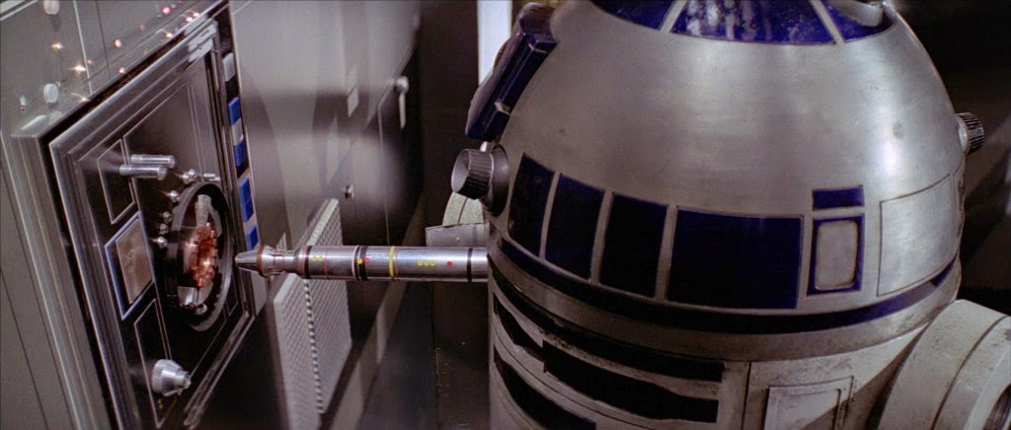
Beep boop

Slide 27
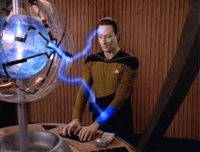
Star Trek TNG Contagion
Responds to a SOS
Finds a partially destroyed ship and a disabled enemy ship
Downloads ships log from damaged ship
Starts having malfunctions
Determine that a probe from a long gone but very advanced civilization scanned and began reprogramming the damaged ship’s computer and the enemy computer in its own image
May seem ridiculous but….FPGA’s are a thing
And post quantum compute makes brute force probably trivial

